Slide 1
Characteristics of Stars
Objectives 2.17 – 2.24

Slide 2
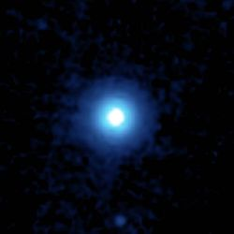
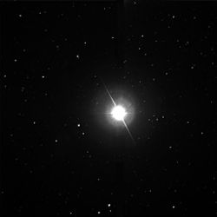
Characteristics of Stars
2.17
What is a star?
Star – a body of gases producing its own energy.
Temperatures 3,000ºC → 50,000ºC
Made of?
H, He, C, N, O

Slide 3
Are all the stars the same color?
2.18
The hottest stars are:
BLUE
The coolest stars are:
RED

Slide 4
Composition of Stars
2.19
Elements give off different colors of light.
Astronomers use the “spectrum” of a star to determine its composition

Slide 5
3 Types of Spectra
Spectroscope Lab
Continuous
Emission (bright line)
3. Absorption (Dark-line):
*Every element has a characteristic spectrum, so a star’s spectrum reveals which elements it contains!*

Slide 6
Star’s Apparent Motion
2.20
Motion of stars visible to the unaided eye in a dark sky, is due to the movement of the Earth.

Slide 7
DOPPLER SHIFT
2.21
Change in WAVELENGTH caused by a change in POSITION

Slide 8
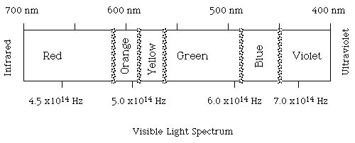
SHORT wavelengths = BLUE color
LONG wavelengths = RED color

Slide 9
Doppler Shift
2.21
APPROACHING objects show a DECREASE in WAVELENGTH
RECEDING (moving away) objects show an INCREASE in WAVELENGTH

Slide 10
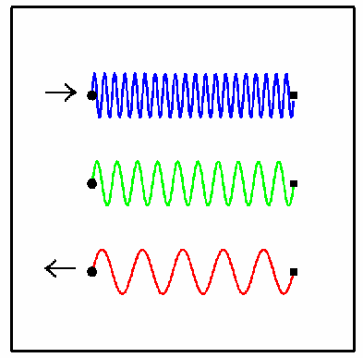
RED SHIFT VS. BLUE SHIFT
2.21
Approaching objects show a BLUE SHIFTED spectrum
Objects moving away show a RED SHIFTED spectrum

Slide 11
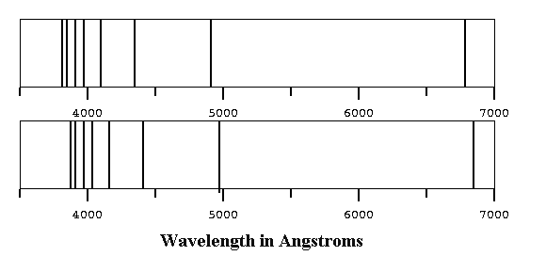
2.21
Star MOVING AWAY from us.
(RED-SHIFTING)
REFERENCE SPECTRUM

Slide 12
Solar System Unit of Measurement
2.22
The astronomical unit (AU ) is a unit of length based on the distance from the Earth to the Sun.
1 Astronomical Unit = 149 598 000 kilometers
(93 million miles).

Slide 13
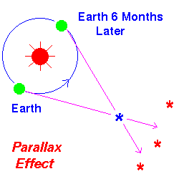
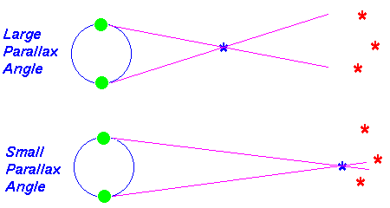
Parallax Method
2.23
The parallax method is a way of measuring distances of far-away objects. Astronomers use parallax to measure the distance to stars. Closer the star is to Earth…the larger the Parallax will be. (use thumb example)

Slide 14
Stellar Magnitude (brightness)
2.24
Apparent Magnitude: Brightness as seen from earth.
Most stars: -5 to +15.
SUN = -26

Slide 15
Stellar Magnitude (brightness)
2.24
Absolute Magnitude: brightness as seen from a standard distance (32 light years)
Most stars: -5 to +15.
Our Sun: +5

Slide 16
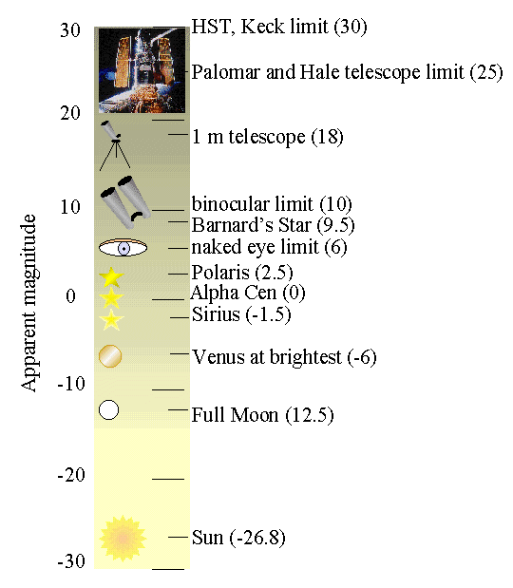
2.24

Slide 17
Astronomy 1
Quest Review
Work with your group
Answer in a “complete answer”
In a way YOU understand it.
All sections up to “Stars” are Due tomorrow

