Slide 1
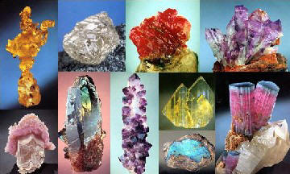
Minerals
A mineral is a naturally occurring, inorganic solid with an orderly crystalline structure and a definite chemical composition.

Slide 2
Minerals
What is a Mineral?
All minerals must have the following characteristics:
Rule #1: Inorganic (salt IS a mineral, sugar is NOT because it is organic)
Rule #2: Naturally occurring by Earth’s processes.
Rule #3: Solid orderly crystalline structure
Rule #4: Definite Chemical Composition

Slide 3
Minerals
How do Minerals Form?
Molten rock material
Volcanoes
Evaporates
- Dissolved elements (evaporated from water)

Slide 4
Minerals
How do Minerals Grow?
Mineral Growth
Draw example on site into your notes.
- Label crystals.

Slide 5
Minerals
9.3 pg. 157
Why are the following materials NOT minerals?
Chunk of Concrete
Brass Ring
Natural Gas

Slide 6
Minerals
Decide if each of the following substances are minerals.
If so, write YES, if NO, list the rule that the substance breaks.
Substance | Yes or No (+Rule Broken) | Substance | Yes or No (+Rule Broken)
Gold |  | Crude Oil
Beach Sand |  | Diamond
Sugar |  | Coal
Salt |  | Steel

