Slide 1
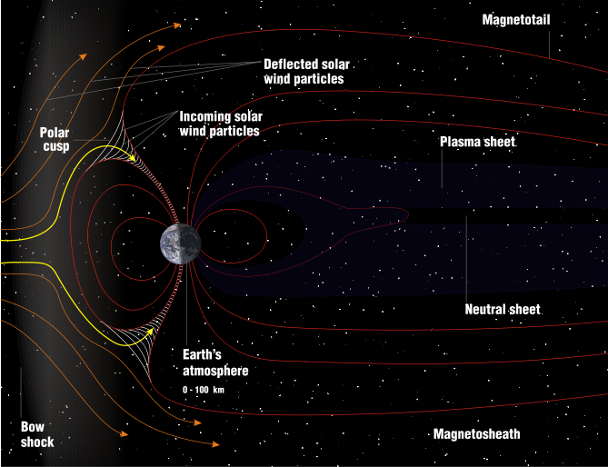
Solar Storms and Aurora’s on Earth

Slide 2
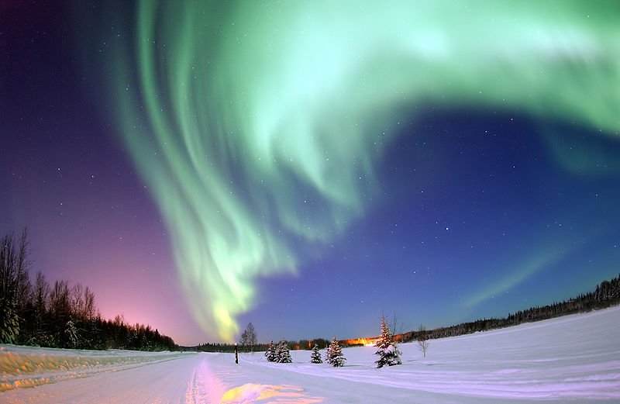

Slide 3
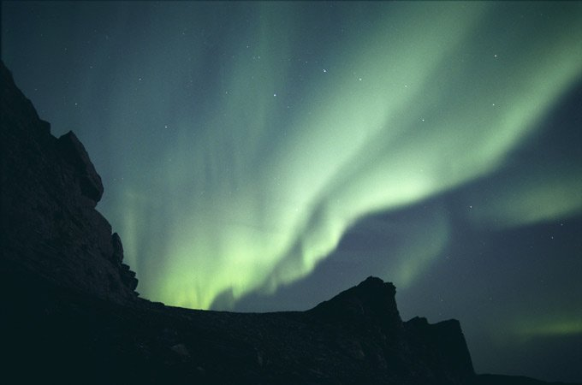
AURORAS (Northern lights)

Slide 4
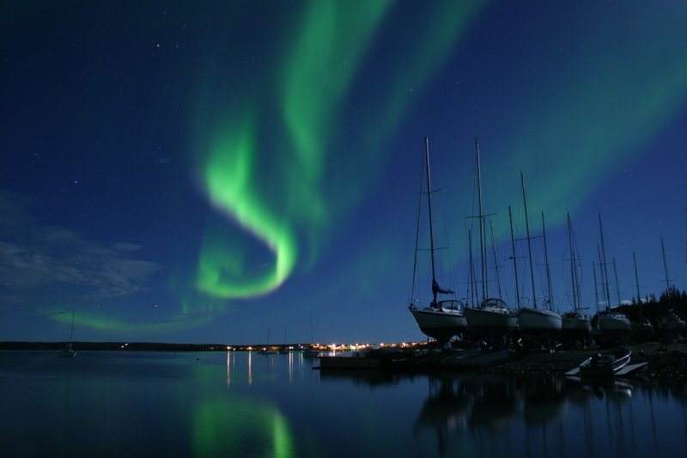
Aurora Borealis
Northwest Territories, Canada

Slide 5
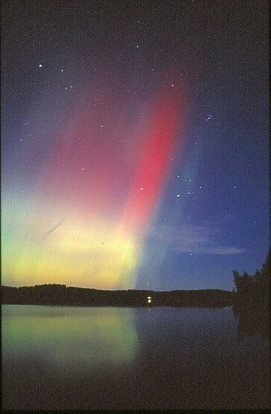
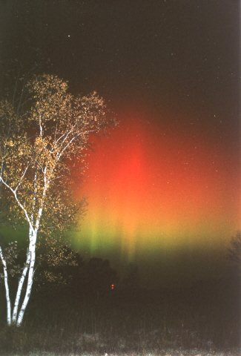
FINLAND (OCT 1, 2001)
MENOMINEE, MI (OCT 11,2001)

Slide 6
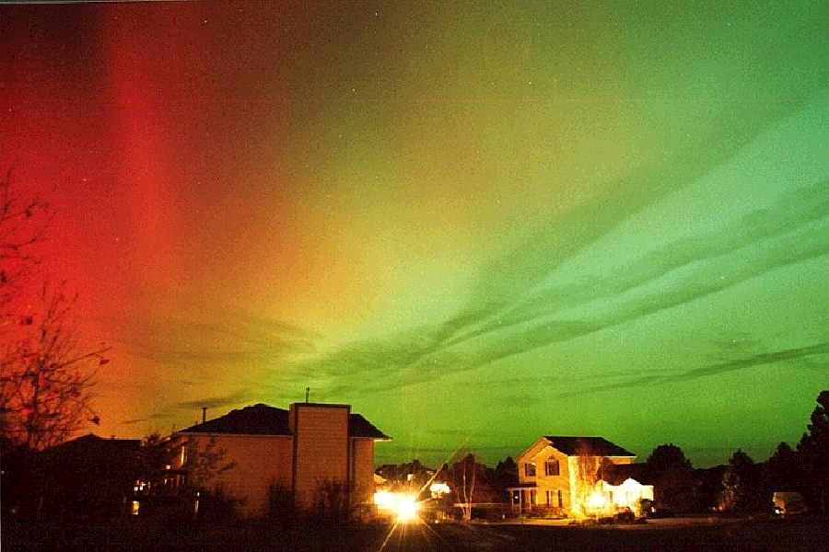

Slide 7
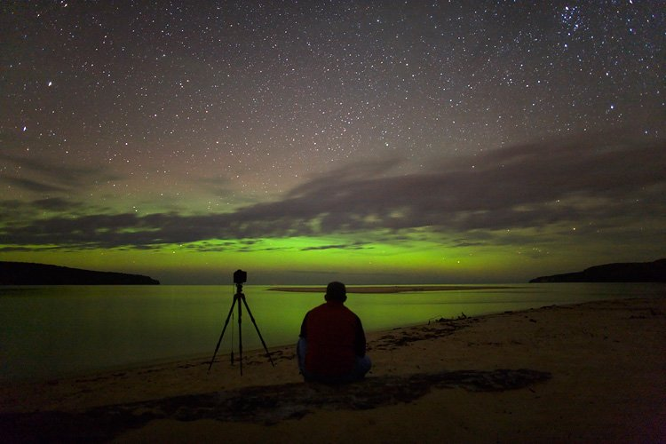
Aurora over Lake Superior

Slide 8
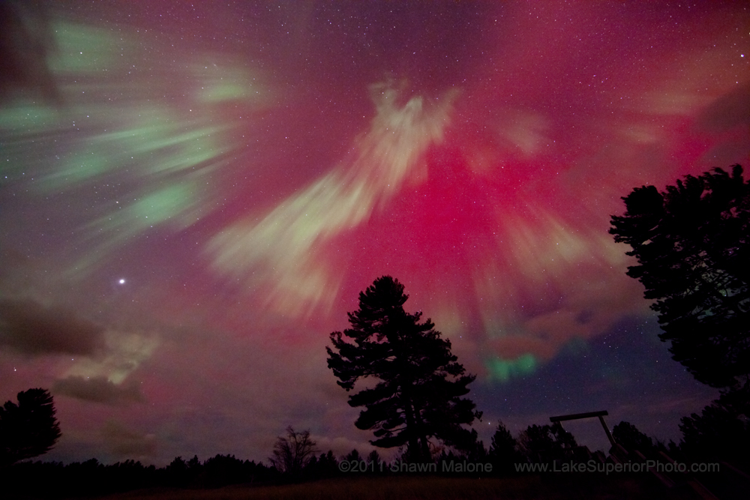
U.P.

Slide 9
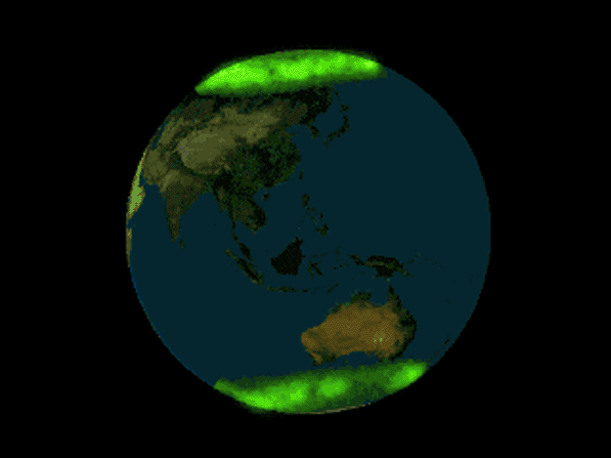
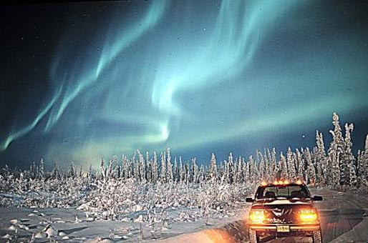
AURORA BOREALIS

Slide 10
So what’s the relationship?
Michigan

Slide 11
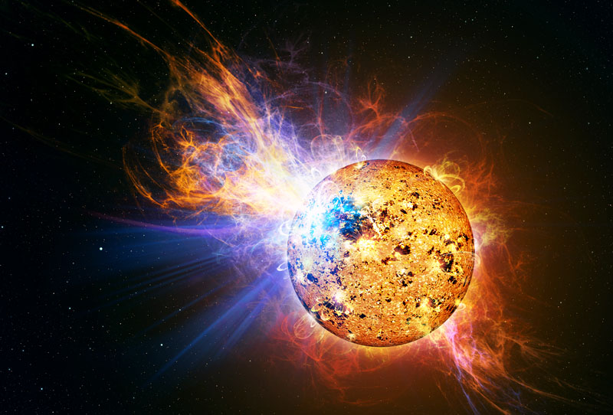
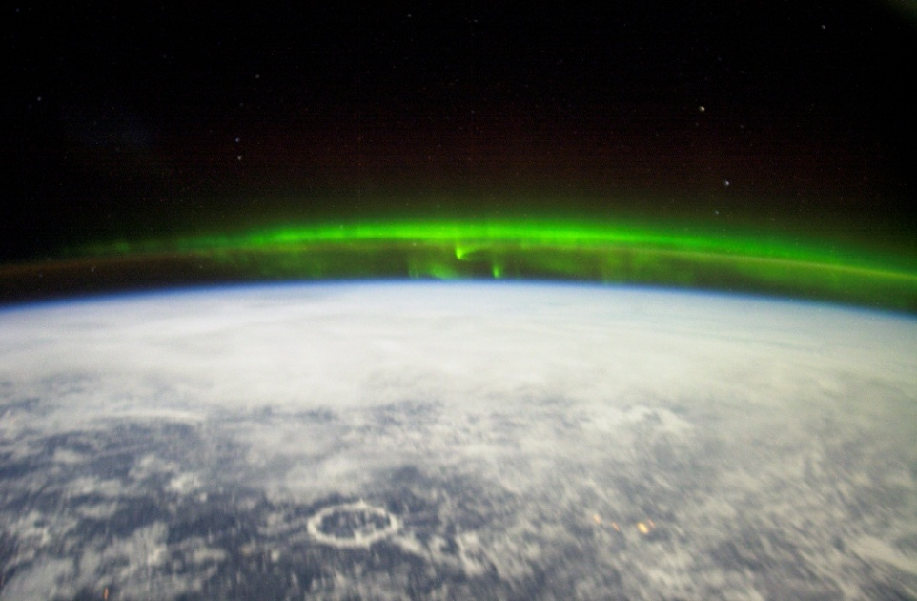
So what’s the relationship?
Solar Activity
Solar activity gets ejected from the sun, Solar Winds carry them through space (towards Earth and other planets), Earth’s Magnetosphere protects the earth by diverting solar winds to the North + South poles, as a result we see Aurora’s (Northern/Southern Lights)
Aurora

Slide 12
Describe the Sunspot cycle
Sunspot (Solar Cycle)
11 Year cycle
Max to Max (min to min) = 11 years
Last Max = 2008
Influences solar activity heading towards Earth (more Aurora’s)

Slide 13
