Slide 1
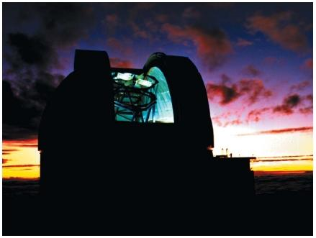
Studying the Stars:
EM Spectrum

Slide 2
Visible Light
WHAT is Visible Light?
What are some Instruments we use to see further into the visible light spectrum of outer space?
Telescopes

Slide 3
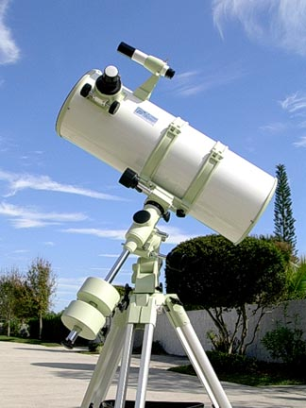
Visible Light Telescopes
Refractor
Reflector

Slide 4
Visible Light Telescopes
Catadopitric

Slide 5
Visible Light
2.14
Challenges
City lights drown out visible star lights
Obstructions of a clear view
Can only see what is visible in the visible light spectrum
Best Place to study Visible Light Astronomy?
Desert (Arizona, Nevada)
High Elevations (Colorado)
Far away from large cities (Hawaii)

Slide 6
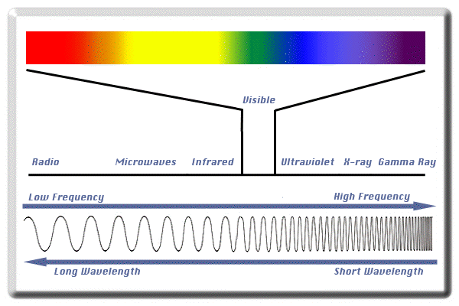
Visible Light Spectrum
Draw spectrum both Color and Size of Wave
2.15

Slide 8
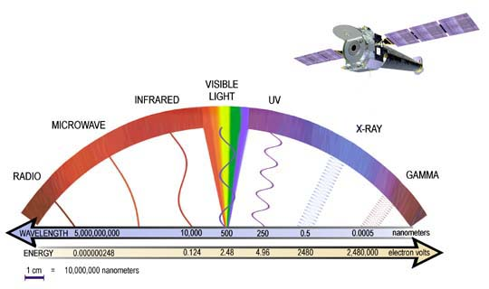

Slide 9
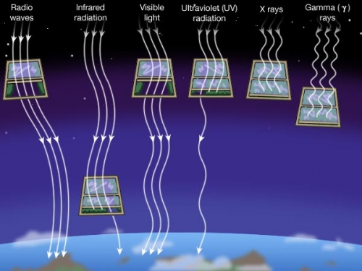
2.15

Slide 10
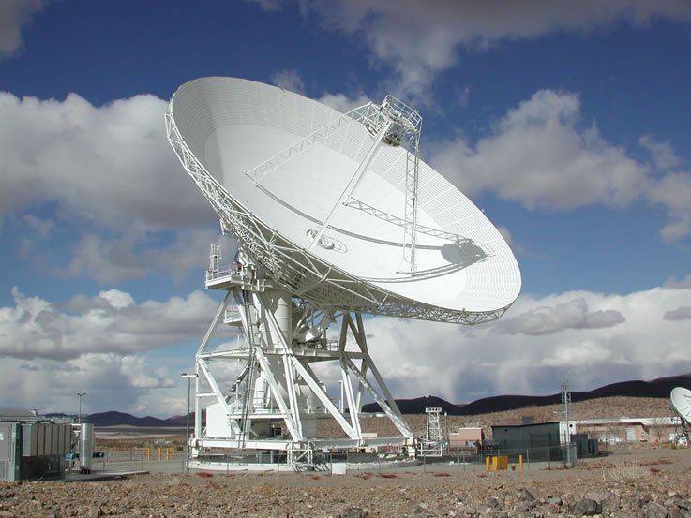
Radio Astronomy

Slide 11
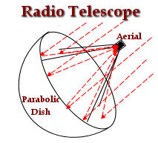
How it Works
Use imagery colors to make a class image using radio waves.

Slide 12
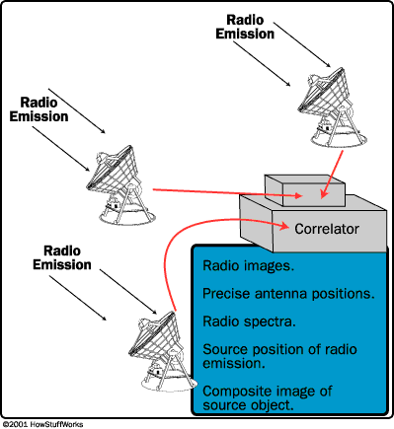

Slide 13
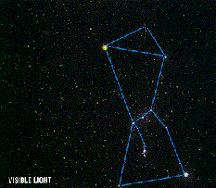
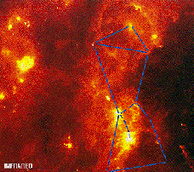
VISIBLE VS. INFRARED

Slide 14
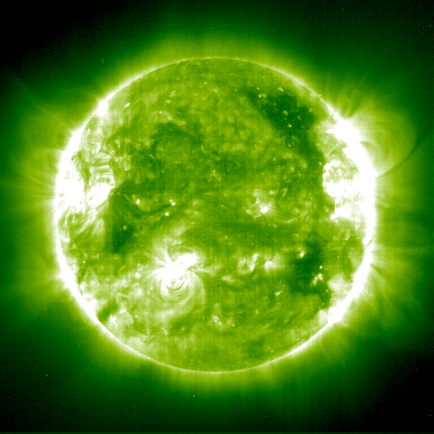
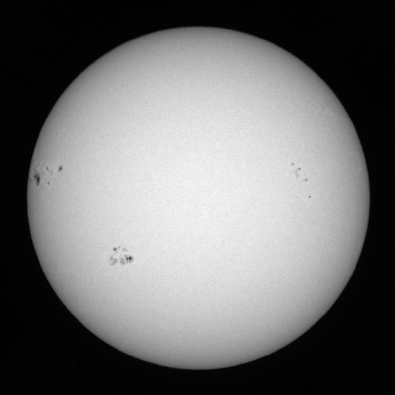
VISIBLE VS. ULTRAVIOLET

Slide 15
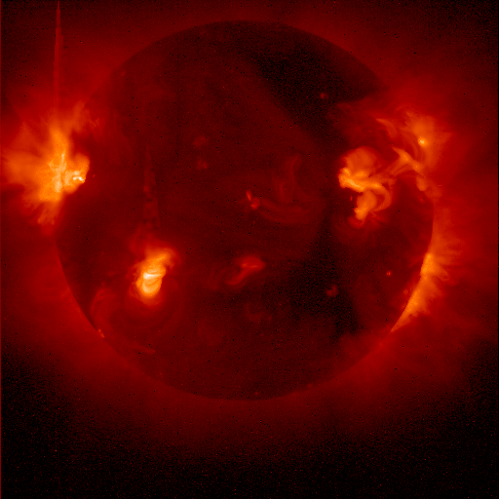
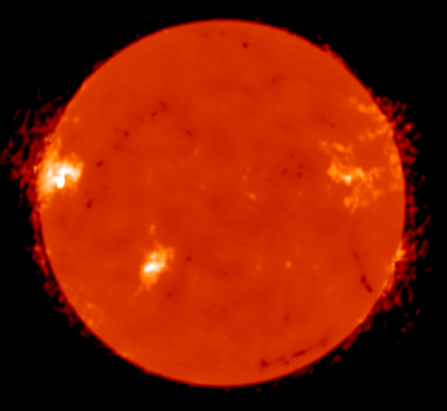
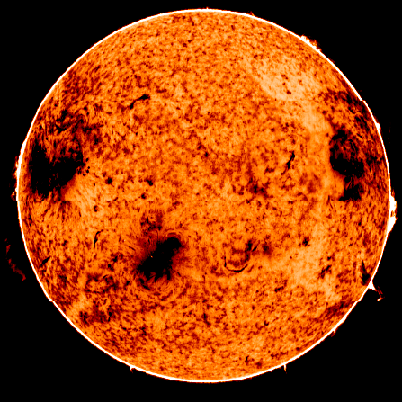
Visible
X-Ray
I R
Radio

Slide 16
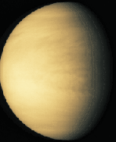
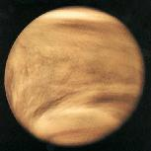
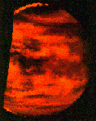
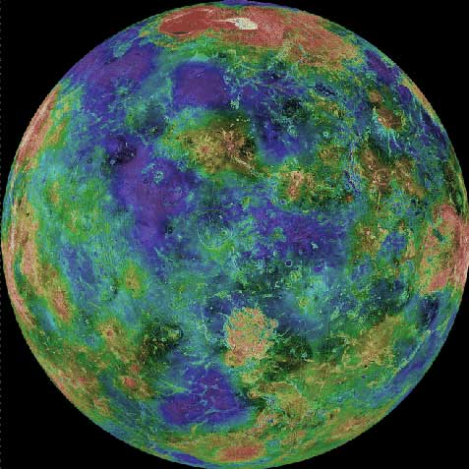
Visible
I R
UV
Radio

Slide 17
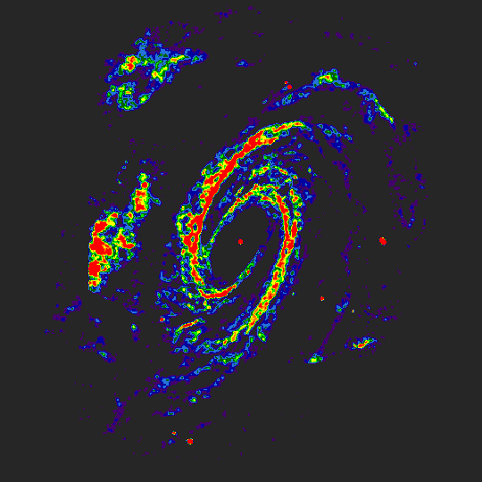
Radio Telescope Image of Galaxy M81

Slide 18
Explain the advantages of using radio telescopes.

