Slide 1
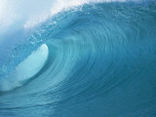
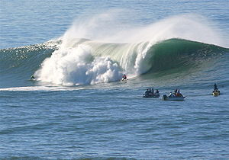
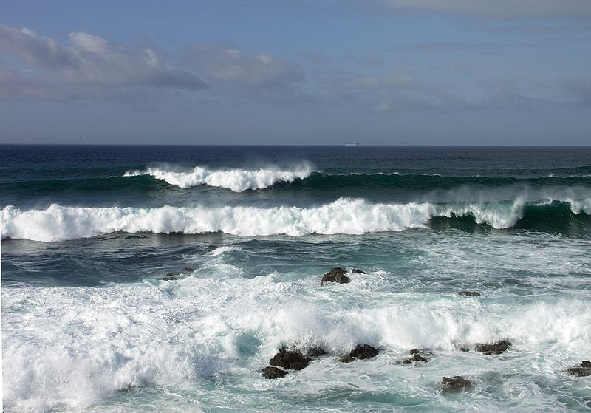
Waves

Slide 2
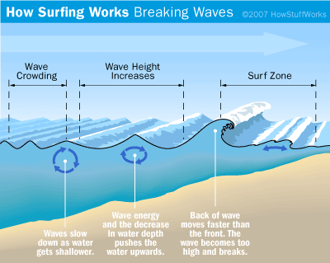

Slide 4
LONG Shore Drift

Slide 5
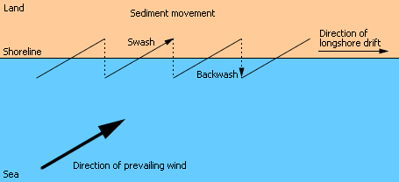
LONG Shore Drift
Longshore drift consists of the transport of sediments along a coast at an angle to the shoreline, which is dependent on prevailing wind direction, swash and backwash.

Slide 6
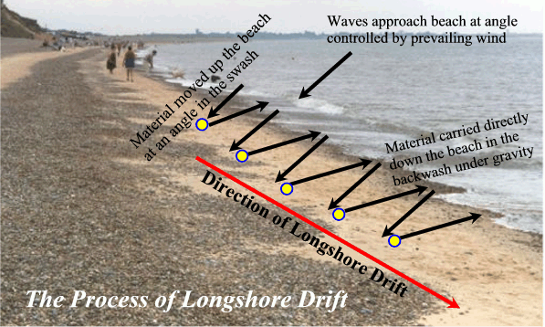
LONG Shore Drift

Slide 7
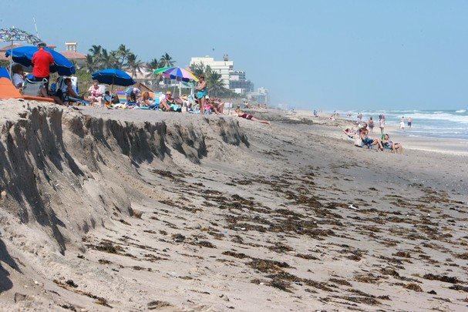
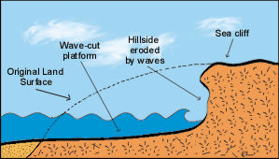
Beach Erosion
Events that cause beach erosion:
Water wave action
Increase in water level

Slide 8
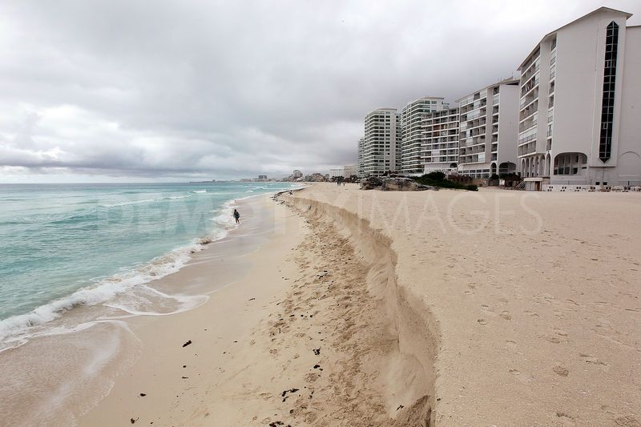
Beach Erosion

Slide 9
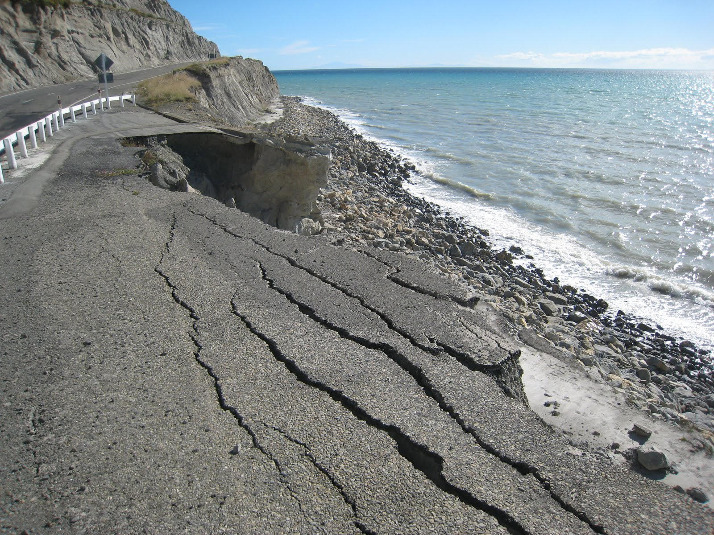

Slide 10
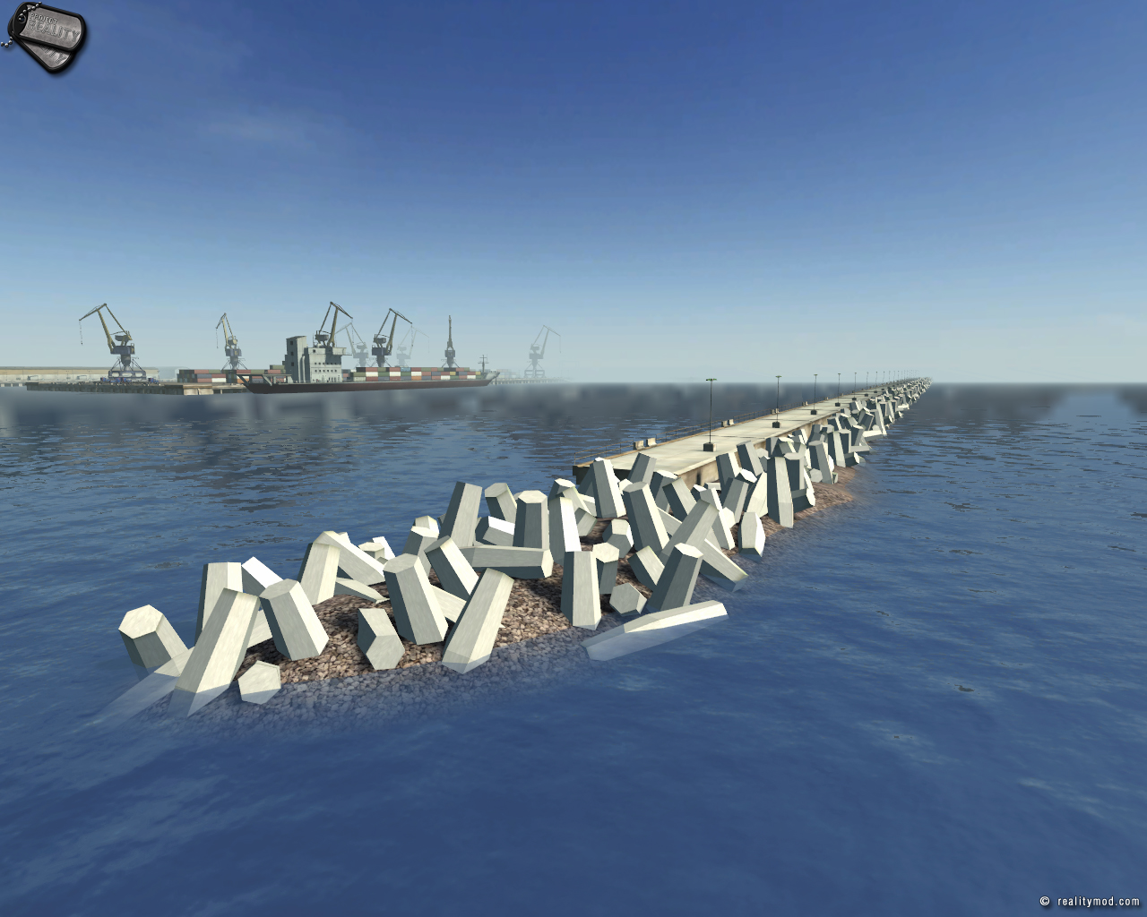
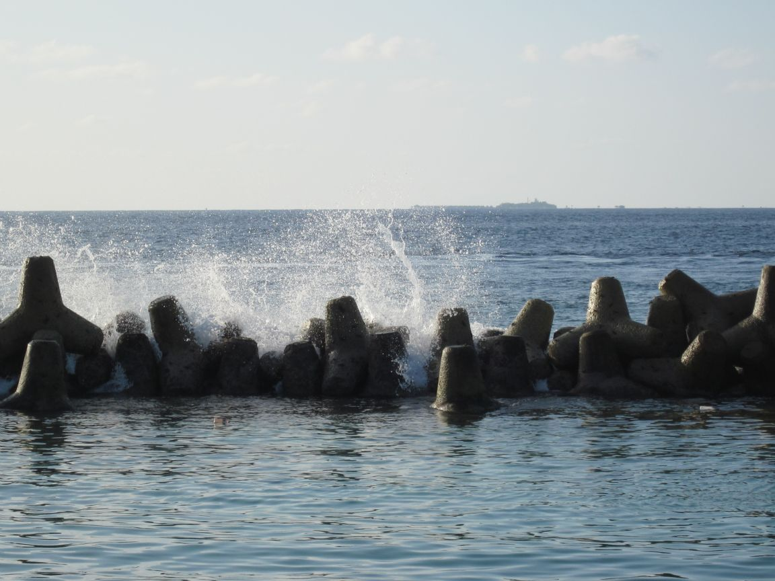
Preventing Beach Erosion
Build wave breaker

