Slide 1
Weathering of Rocks

Slide 2
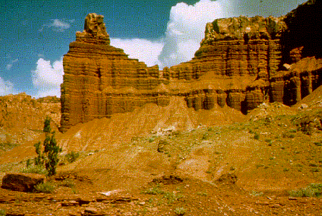
Weathering
The change in the physical form or chemical composition of rock materials exposed at the earth’s surface.

Slide 3
Weathering
Mechanical weathering: processes physically break rock into smaller pieces, but do not change chemical composition.
Chemical weathering: processes break down rock by changing its chemical composition.
Go to pg. 219-223. Fill in the table 13.2

Slide 4
Occurs when water seeps into cracks or joints in rocks and freezes.
(EXPANDS as it freezes).

Slide 5
Exfoliation
Sheets of rock peel or flake off.

Slide 6
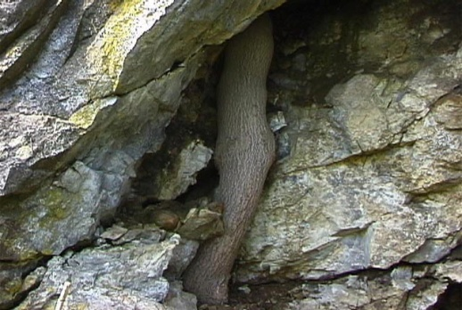
Plant Roots
Roots of plants and trees find way through cracks in rocks and break apart.

Slide 7
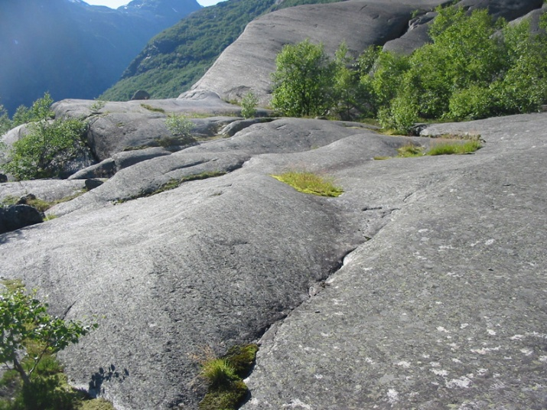
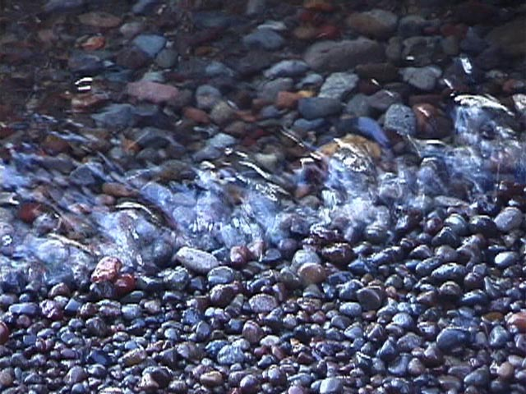
Abrasion
Collision of rocks with one another, breaks and wears away surfaces.

Slide 8
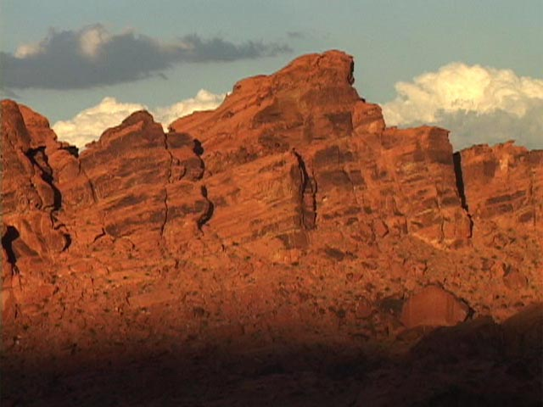
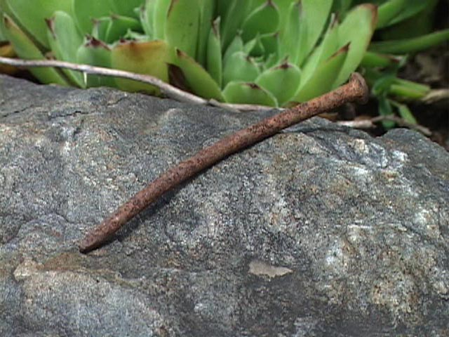
Oxidation
Metallic elements combine with Oxygen.
(Rusting occurs)

Slide 9
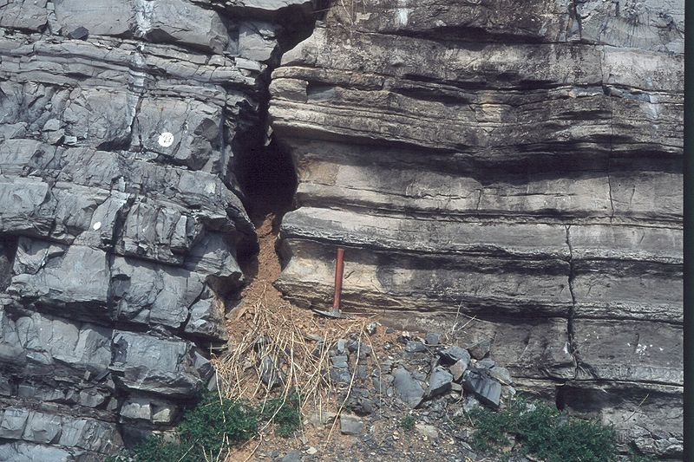
Hydrolysis
Change of rock composition as it reacts with Water.

Slide 10
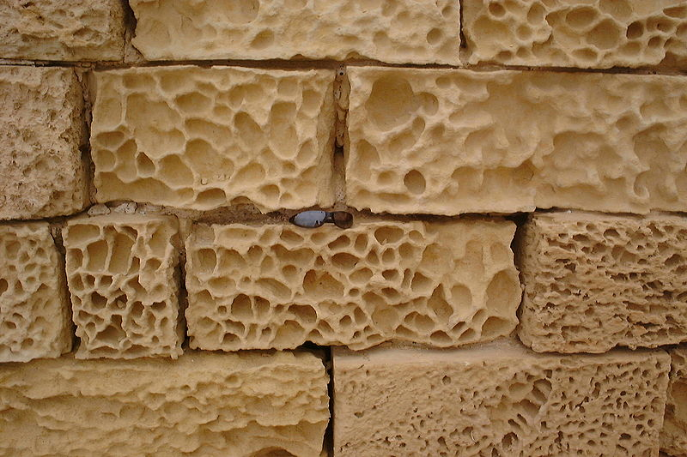
Dissolution
Dissolving away of rock material.

Slide 11
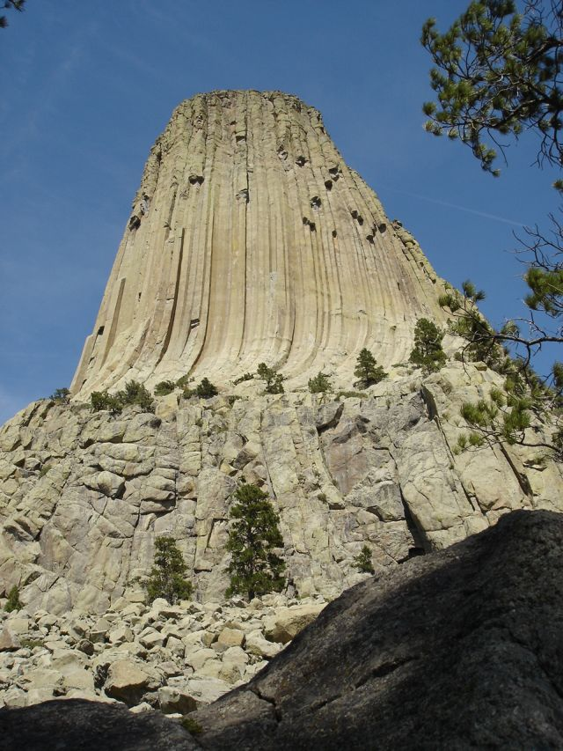
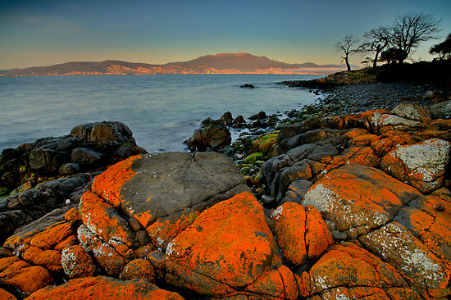
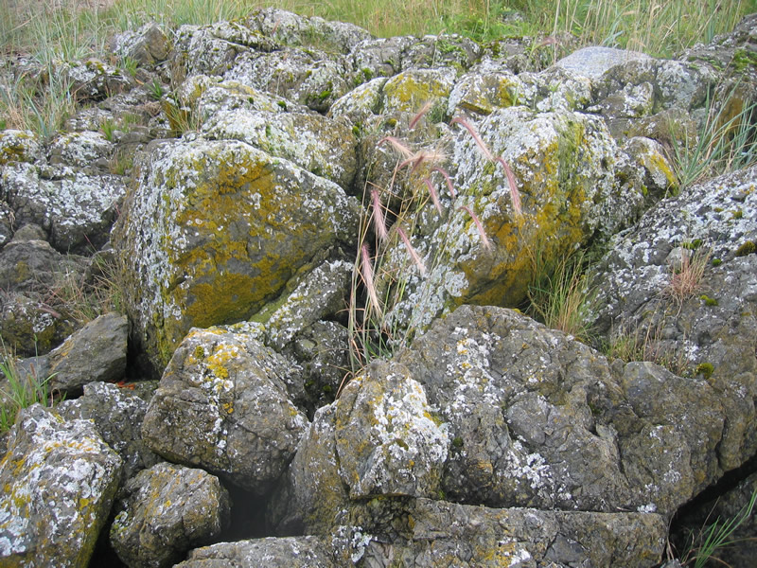
Plant Acids
Mosses and Lichens produce weak acids that break down rock.

Slide 12
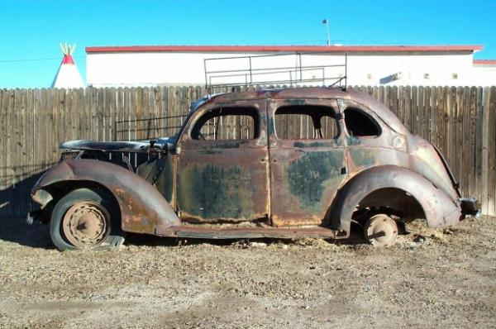
The Price of Corrosion
Go to pg. 223 OBJECTIVE 17.8
Read the article “The Price of Corrosion”
Answer the three questions that follow on your objective notes

Slide 13
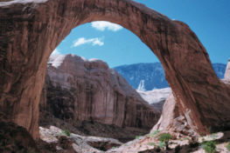
HOMEWORK
Objective’s 17.9 + 17.10
Pg. 224-226

