Slide 1
Young Streams vs. Old Streams
Young Streams vs. Old Streams

Slide 2
How river systems change from young to mature!
YOUNG
MATURE
Wide Channels
Large floodplains
Lateral erosion
Gentle slopes
Meanders, oxbows
Fine sediment
Narrow channels
Small floodplains
Downcutting
Steep slopes
Rapids, waterfalls
Coarse sediment

Slide 3
YOUNG Stream
V – shaped valleys
Erodes away at bed (more than sides)
Waterfalls and Rapids are common.
Few Tributaries

Slide 4
OLD Rivers
Well established tributaries
Drains effectively
Carries LARGE amounts of water
Does not get deeper, (Erodes from Sides)

Slide 5
YOUNG Stream
Mature Stream/River
OLD River

Slide 6
FLOODS
Stream overflows channel
Causes
Weather events
Dams break
(+) Provides “fertilizer” for floodplain
(-) Most destructive of all geologic hazards

Slide 7
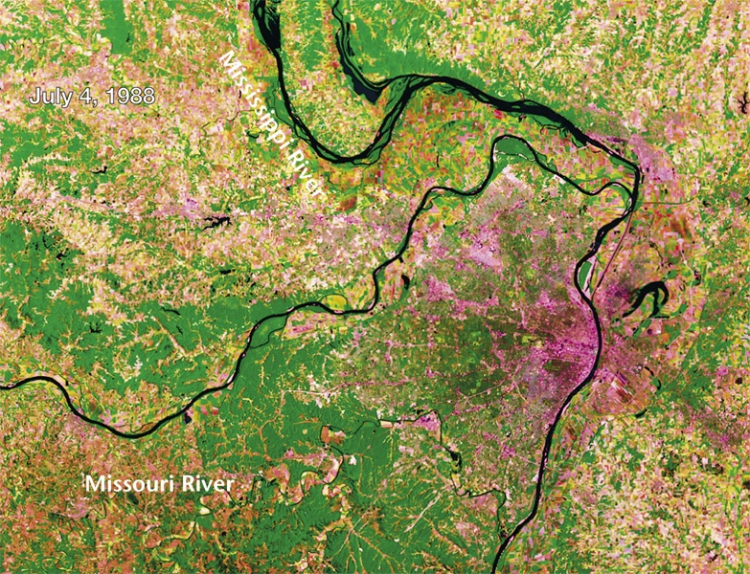
Missouri & Mississippi Rivers (Satellite view near St. Louis)

Slide 8
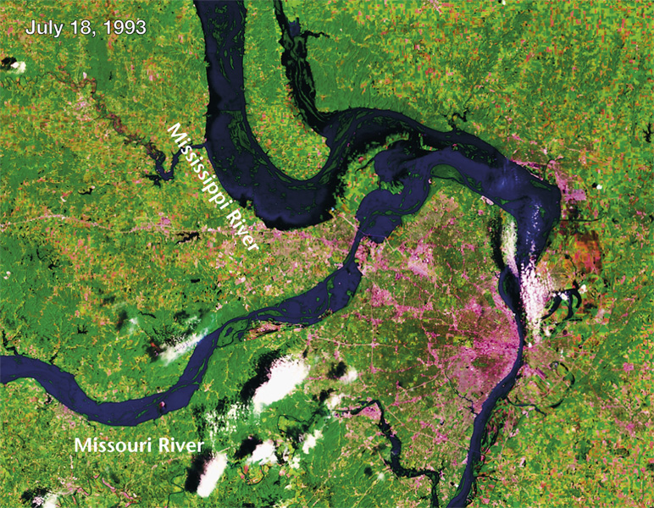
Same satellite view during flooding in 1993

Slide 10
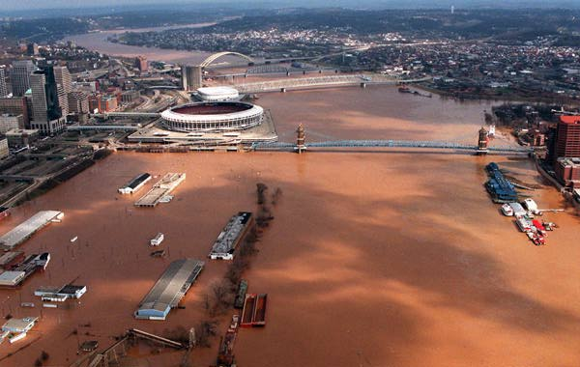
Cincinnati, OH

Slide 11
Describe human decisions that increase the risk of flooding.
Disturbing vegetation that uses water and returns it to the atmosphere before flooding occurs.
Building
Grazing animals
Farming practices like clear-cutting land
Cutting down forests

Slide 12
FLOOD CONTROL
Dams

Slide 13
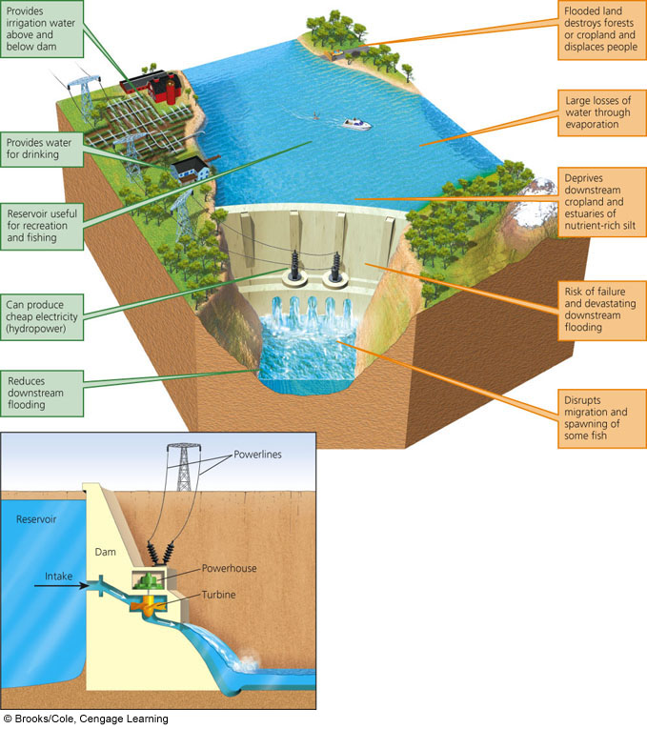
Fig. 13-12, p. 325
Notes:
Figure 13.12
Trade-offs: advantages (green) and disadvantages (orange) of large dams and reservoirs (Concept 13-3). The world’s 45,000 large dams (higher than 15 meters or 49 feet) capture and store about 14% of the world’s runoff, provide water for almost half of all irrigated cropland, and supply more than half the electricity used by 65 countries. The United States has more than 70,000 large and small dams, capable of capturing and storing half of the country’s entire river flow. Question: Which single advantage and which single disadvantage do you think are the most important? Why?

Slide 14
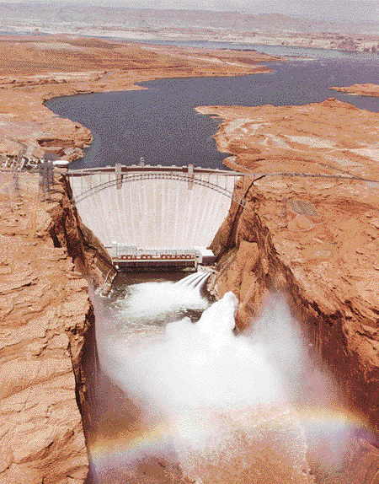
Glen Canyon Dam, Page, AZ
(Lake Powell in background, Colorado River in foreground)

Slide 15
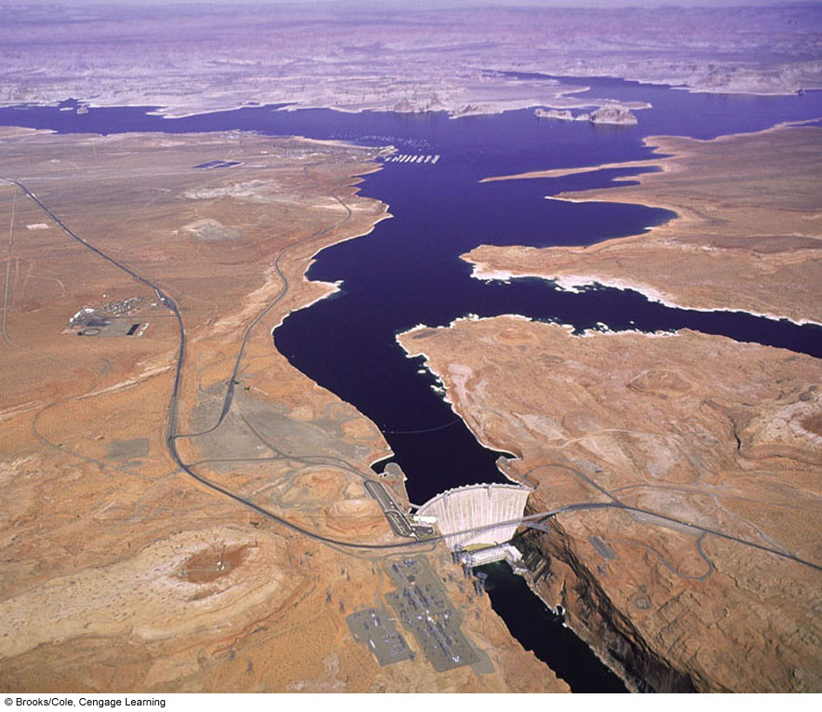
Fig. 13-15, p. 327
Notes:
Figure 13.15
Aerial view of Glen Canyon dam built across the Colorado River in 1963 and its reservoir called Lake Powell, the second largest reservoir in the United States.

Slide 16
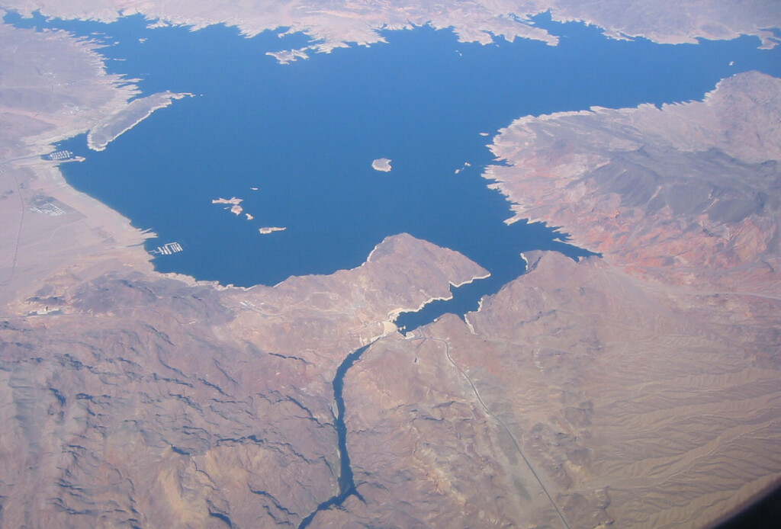

Slide 17
LAG TIME
The time difference between when heavy precipitation occurs and when peak discharge occurs in the streams draining area.
Urban
Lots of pavement, buildings, etc.
Causes very quick movement of water into river system
“Flash Flood”
Rural
Lots of farm land, less roads and buildings
Slower movement of water, more absorbed by soil

Slide 18
3 ways to prevent flooding
Look over attached handout:
Dams
Artificial Levees
Channels

Slide 19
Trace the path(s) that 99% of water travels through the Great Lakes watershed.
USE Michigan Waterways handout

Slide 20
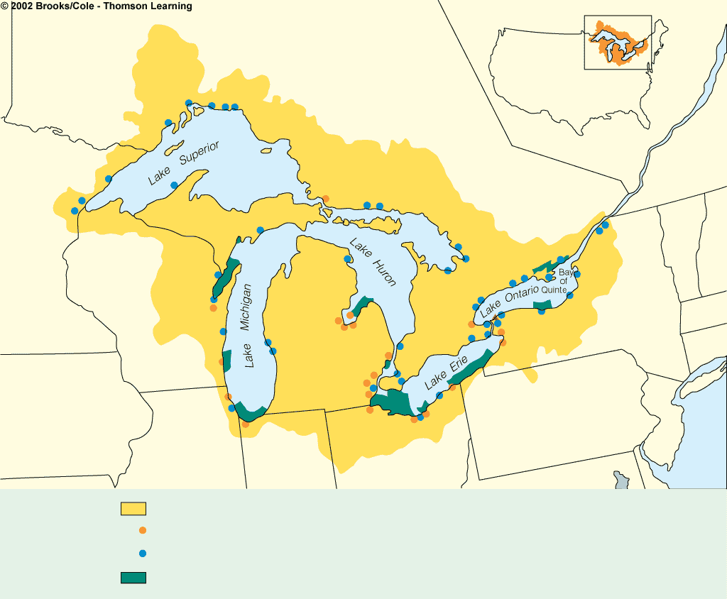
CANADA
Nipigon Bay
Thunder Bay
Jackfish Bay
Silver Bay
St. Mary’s R.
St. Lawrence R.
St. Louis R.
Spanish R.
MICHIGAN
Penetary Bay
WISCONSIN
Sturgeon Bay
MICHIGAN
Saginaw
Bay
Saginaw R.
System
Grand R.
Niagara Falls
NEW YORK
MINNESOTA
Niagara R.
St. Clair R.
Thames R.
Buffalo R.
Detroit R.
Rouge R.
Raisin R.
IOWA
Ashtabula R.
PENNSYLVANIA
Maumee R.
Cuyahoga R.
Black R.
Rocky R.
ILLINOIS
INDIANA
OHIO
Great Lakes drainage basin
Most polluted areas, according to the Great Lakes Water Quality Board
“Hot spots” of toxic concentrations in water and sediments
Eutrophic areas
Fig. 19.7, p. 484

Slide 21
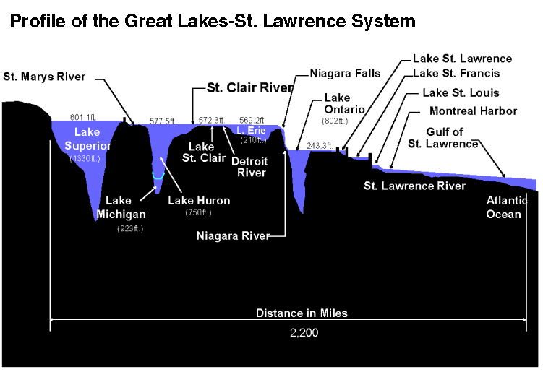
http://techalive.mtu.edu/meec/module08/GreatLakesFlow.htm

Slide 22
Great Lakes Watershed

